Slide 1


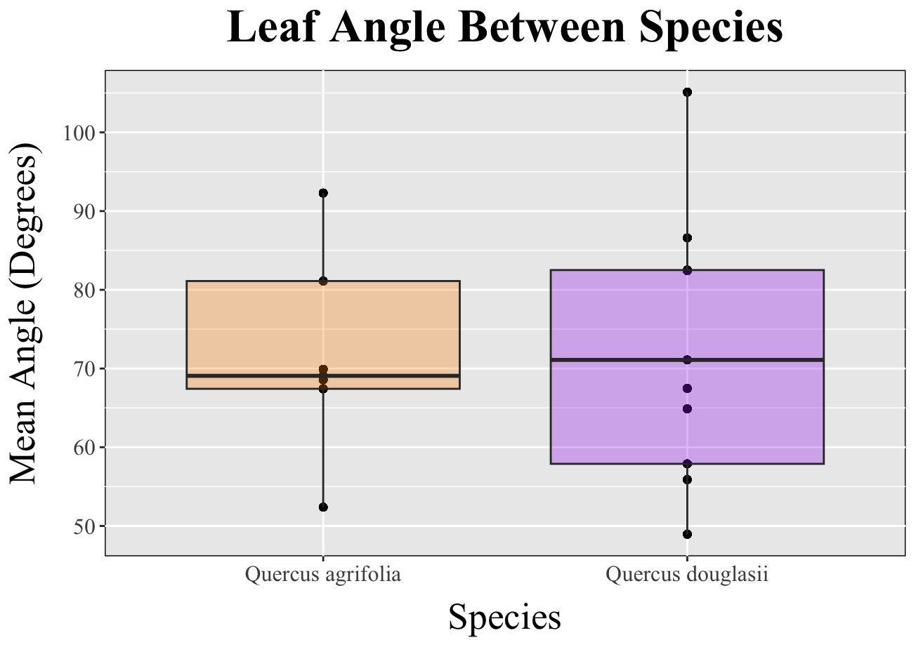
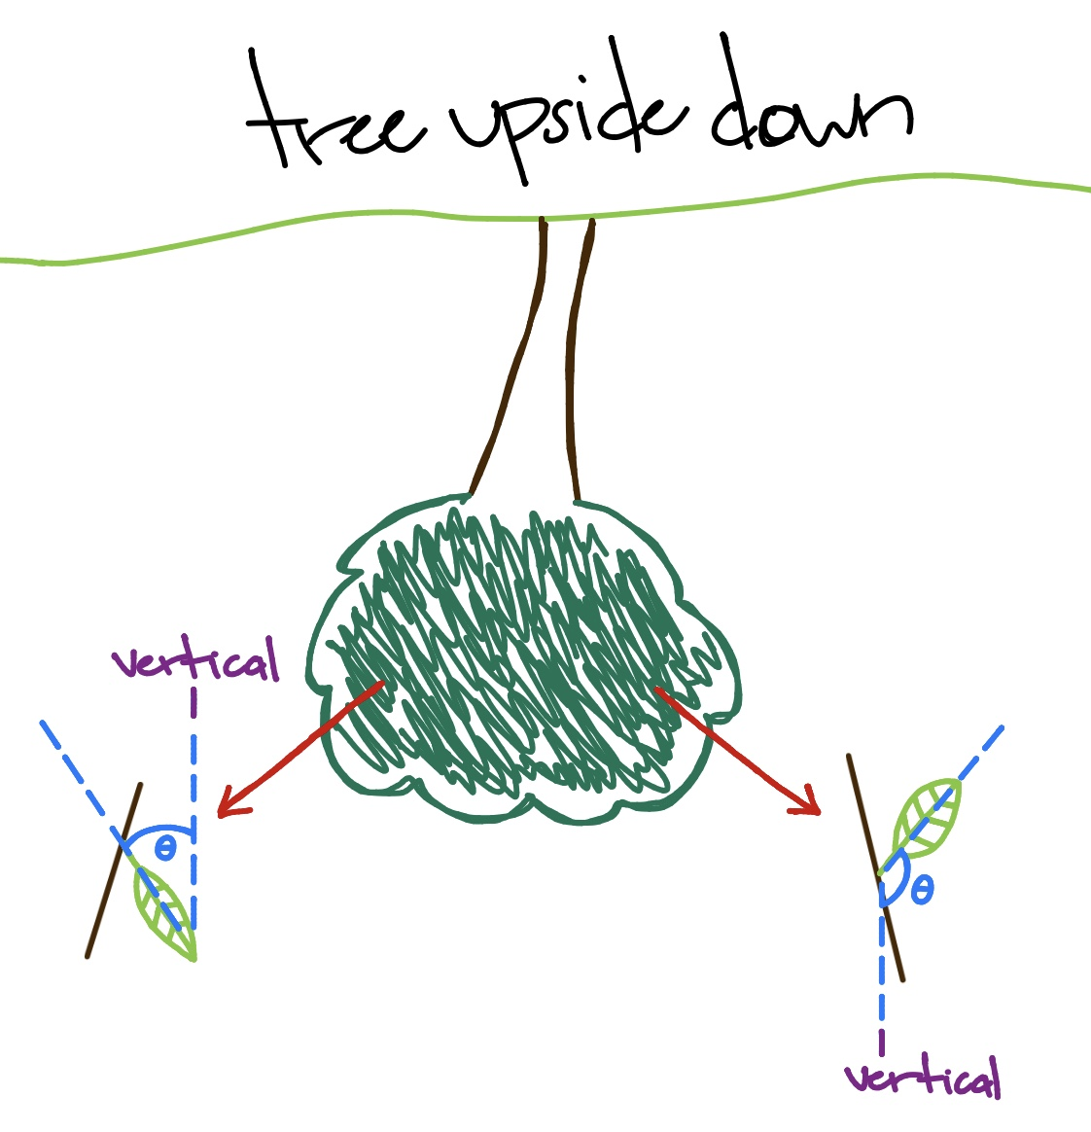
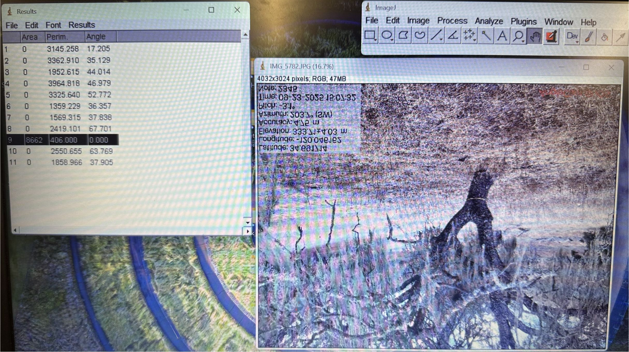
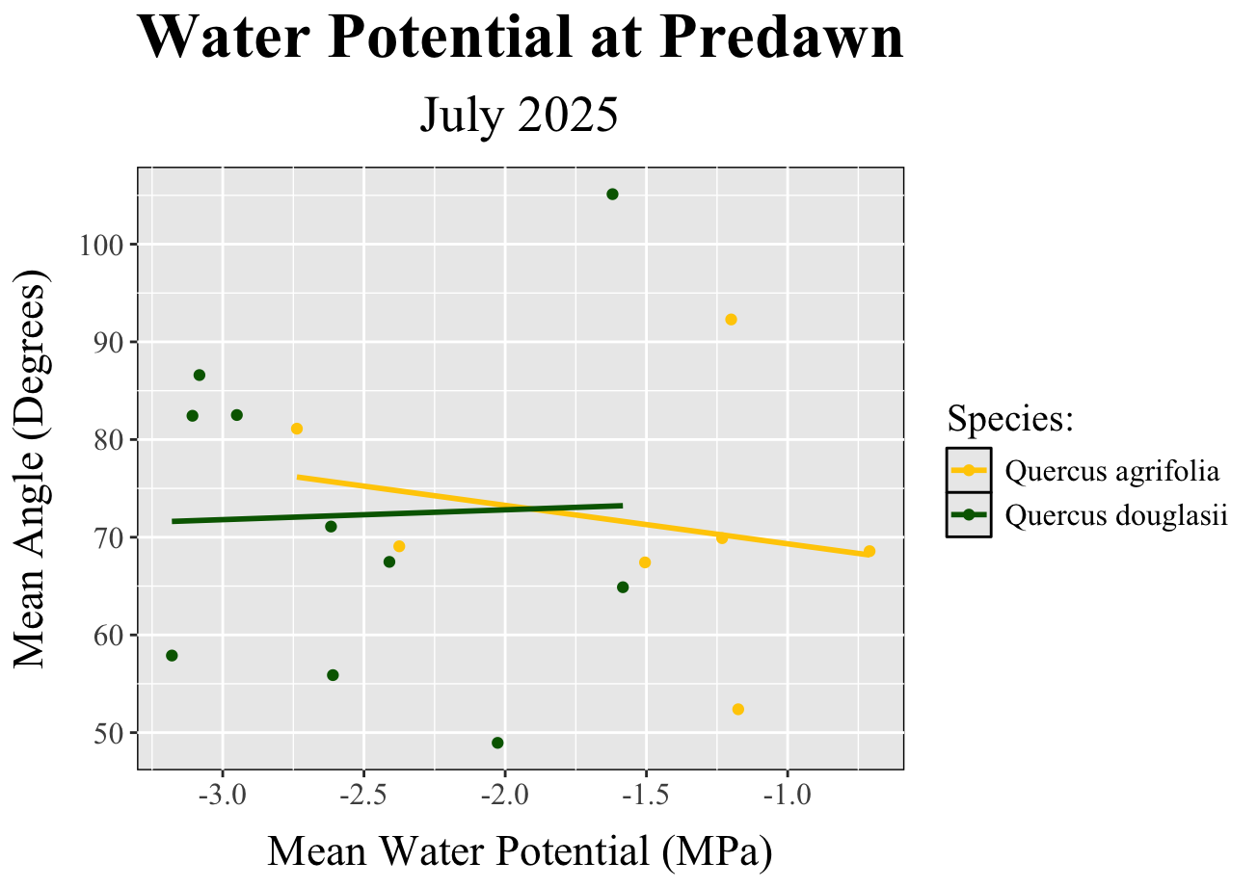
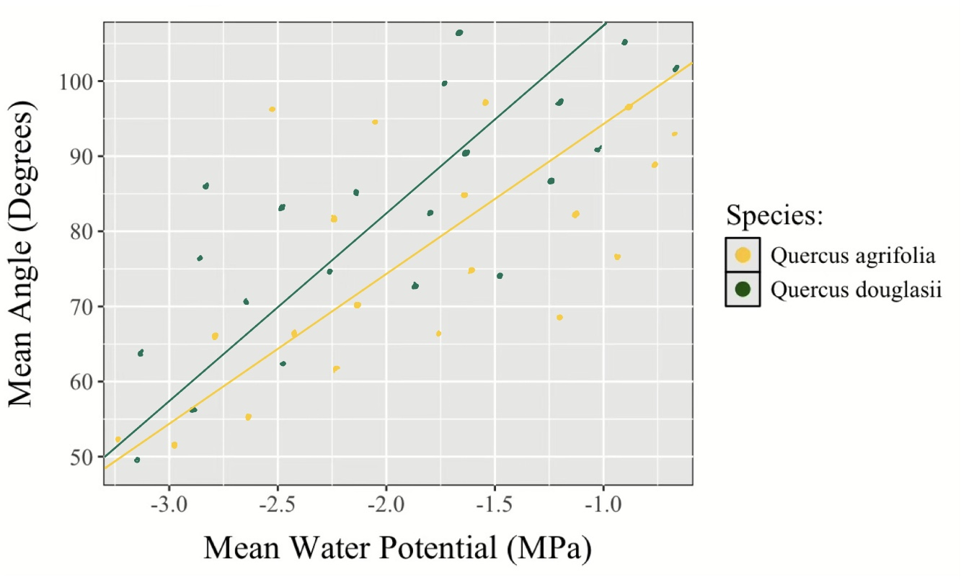
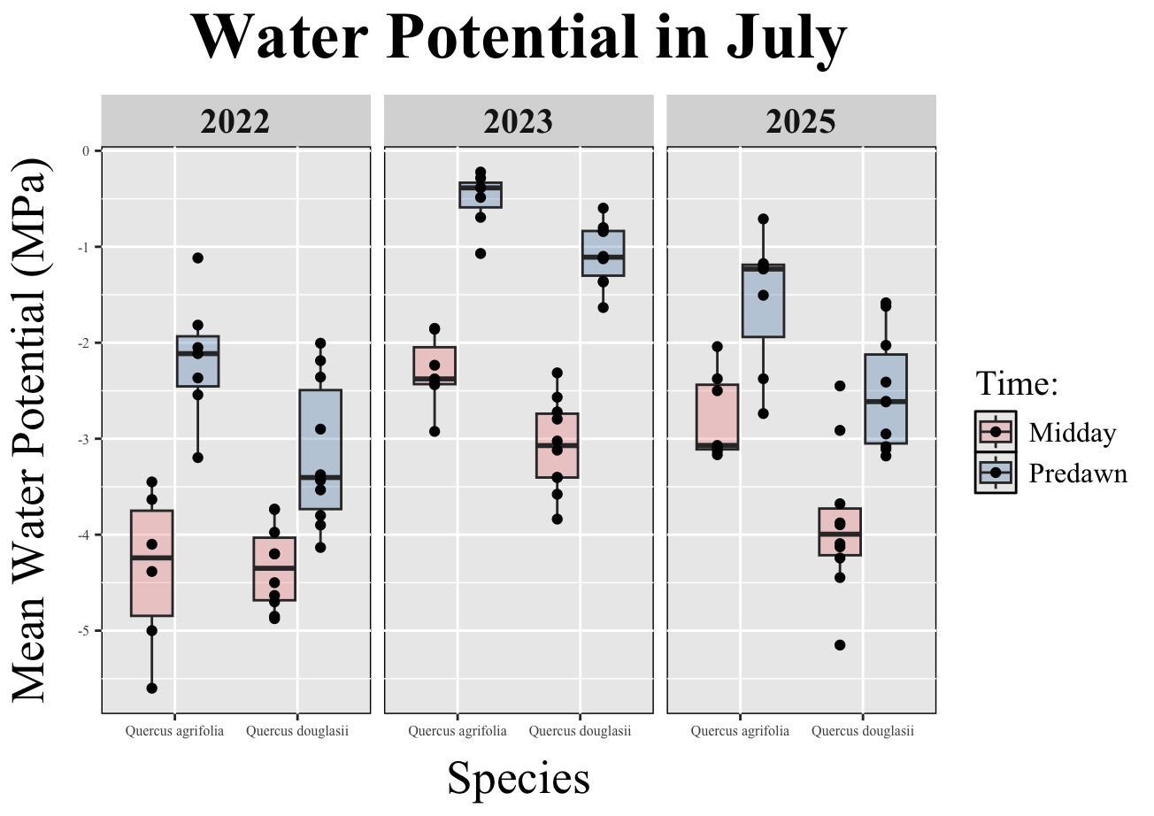
Quantifying leaf angle and its relationship to water availability from two California oak species
Steven Le, Indra Boving, Leander Anderegg
BACKGROUND:
METHODS:
RESULTS:
Climate change has led to rising temperatures and more severe droughts in California
Native oak species are prevalent in California’s woodlands, where they have had to develop responses to new stressors
Leaf angle is important In hot and dry climates
Leaf angle adjustment in oak species may be a response to high drought stress conditions
Gathered data from 20 coast live oaks, Quercus agrifolia, and blue oaks, Quercus douglasii, total
Selected 2 images/tree and measured 10 leaves/image
Recorded azimuth, pitch, and angle of photo taken given
Used imageJ to measure angle related to straight line (leaf angle) for each of the 10 leaf samples per image
Analyzed average leaf angle between species by creating boxplot figure on RStudio
Developed boxplots for average water potential of oaks based on driest month (July) for three years (2022, 23, 25)
Combined leaf angle and water potential data
Compared average water potential (x) to average leaf angle (y) based on time of day (predawn vs. midday)
QUESTIONS/HYPOTHESES:
Figure 2. Average leaf angles between coast live oaks, Quercus agrifolia, and blue oaks, Quercus douglasii.
What are different methods to measuring leaf angle?
Figure 2. Average water potential at predawn in comparison to average leaf angles for coast live oaks, Quercus agrifolia, and blue oaks, Quercus douglasii..
CONCLUSION:
No relationship between leaf angle and drought stress
Blue oaks show greater drought stress in comparison to coast live oaks for July in all three years
High variability in leaf angle for each individual tree
Need more data collection and samples of leaf angle
Direct vs. indirect methods for measuring leaf angle
Does lower mean water potential indicate a lower or higher mean leaf angle response, if at all? Is there any variation between mean leaf angle of the two oak species in similar conditions?
1. Holder, C. D. (2012). The relationship between leaf hydrophobicity, water droplet retention, and leaf angle of common species in a semi-arid region of the western United States. Agricultural and Forest Meteorology, 152(1), 11–16. https://doi.org/10.1016/j.agrformet.2011.08.005
2. Li, S., Fang, H., & Zhang, Y. (2023). Determination of the Leaf Inclination Angle (LIA) through Field and Remote Sensing Methods: Current Status and Future Prospects. Remote Sensing, 15(4), 946. https://doi.org/10.3390/rs15040946
3. McNeil, B. E., Písek, J., Harald Lepisk, & Flamenco, E. A. (2016). Measuring leaf angle distribution in broadleaf canopies using UAVs. Agricultural and Forest Meteorology, 218-219, 204–208. https://doi.org/10.1016/j.agrformet.2015.12.058
Figure 1. Water potential for coast live oaks, Quercus agrifolia, and blue oaks, Quercus douglasii, at different times of the day for three years.
Notes:
ggsave(plot = alas_size_spp, #plot name
filename = here::here("figures", "trait_data"),#where to save to "alas_size_spp.jpg"),
width = 5,
height = 8,
dpi = 600,
units = "cm" #"in
)

